Slide 1
Ventilation and perfusion
Tania Warnakulasuriya
Department of Physiology

Slide 2
At the end of the lecture the student should be able to,
describe regional ventilation of lungs
describe regional blood flow in the lungs and the lung “zones” that exist in the upright, human lung
explain ventilation-perfusion relationships in different parts of the lung
give examples of ventilation-perfusion mismatch
explain “physiological dead space”
explain “physiological shunt”

Slide 3
Regional ventilation in the lungs
Ventilation of all parts of the lung are not uniform
Affected by
gravity
smooth muscle control of airway diameter
age
diseases etc.

Slide 4
Effect of gravity on ventilation
In inspiration,
ventilation at base of lung is more than at apex
At end expiration,
ventilation at apex is more than at base
base is more ‘crushed’ – due to weight of overlying lung
Overall
ventilation at base of lung is more than at apex

Slide 5
Regional blood flow in the lungs
The distribution of pulmonary blood flow is also not uniform
More blood flow to the base
Effect of gravity

Slide 6
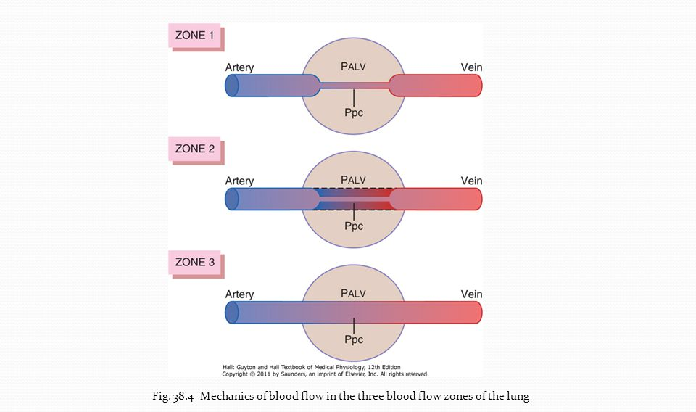
Pulmonary blood flow according to the area
Zone 1 is not found in normal healthy lungs
Apices of lungs
Lower areas of lungs

Slide 7
Zone 1 FLOW
No blood flow at any time of the cardiac cycle
P_{alv} > P_{pc} : pulmonary vessels closed; no blood flow
P_{alv}
e.g. positive pressure ventilation ↑ Palv
e.g. severe blood loss ↓ Ppc

Slide 8
Zone 2 FLOW
intermittent blood flow throughout cardiac cycle
when Ppc > Palv
pulmonary vessels open
blood flow present
when Palv > Ppc
pulmonary vessels close
no blood flow
P_{alv}

Slide 9
Zone 3 FLOW
Continuous blood flow throughout cardiac cycle
P_{pc}> P_{alv} : pulmonary vessels open; blood flow continuous

Slide 10
In the normal lung…
APEX has zone 2 BLOOD FLOW
apex has more ventilation than perfusion
P_{alv} >>> P_{pc}
therefore relatively less perfusion at apex
in systole; P_{pc}=10 mmHg P_{alv}=0 mmHg; blood flow present
in diastole; P_{pc}=-7 mmHg P_{alv}=0 mmHg; no blood flow

Slide 11
Towards base of lung, it becomes zone 3 BLOOD FLOW
hydrostatic pressure in capillaries increases with gravity
P_{pc}> P_{alv} in both systole and diastole; continuous blood flow
therefore relatively more perfusion at base

Slide 12
Situations where there is continuous blood flow at any time of the cardiac cycle
When a person is lying down effect of gravity is removed
In exercise, blood flow increases to all parts of the lungs

Slide 13
Ventilation /perfusion ratio (V_{A}/Q ratio)
There is gradual increase in both ventilation (V_{A}) and perfusion (Q) from apex to base of lung
Since blood is denser than air and due to effect of gravity, increase in perfusion is more
Therefore V_{A}/Q ratio decreases from apex to base

Slide 14
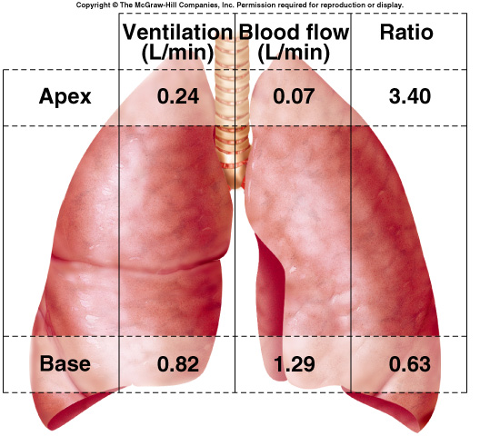

Slide 15
Ideally V/Q ratio = 1
Optimal ventilation
Optimal perfusion
Optimal V_{A} : Q matching

Slide 16
In the normal lungs at rest
Alveolar ventilation (V_{A})
= 4 L/min
Pulmonary blood flow (Q)
= 5 L/min
V_{A}/Q ratio = 0.8

Slide 17
There are small variations in V_{A}/Q ratios in a healthy person due to effect of gravity
In respiratory disease, the variations in V_{A}/Q ratios can become significantly larger

Slide 18
What are these variations?
Some alveoli have more ventilation than perfusion (increased V_{A}/Q ratio)
Some have more perfusion than ventilation (decreased V_{A}/Q ratio)
Ventilation perfusion mismatch

Slide 19
Now let’s look at examples of Ventilation-perfusion mismatch

Slide 20
Decrease in V_{A}/Q ratio
Poorly ventilated alveoli
Well perfused with blood
PaO₂ drops
PaCO₂ rises
E.g. asthma

Slide 21
no ventilation; V=zero; V_{A}/Q ratio=0
O₂ and CO₂ concentrations in pulmonary veins are similar to blood entering the pulmonary arteries; (mixed venous blood)
Equivalent to a right-to-left shunt
ALVEOLAR SHUNT

Slide 22
Increase in V_{A} /Q ratio
Well ventilated alveoli
Poorly perfused with blood (high V/Q ratio)
More available O₂ in alveoli = “wasted ventilation”
P_{A}O₂ and P_{A}CO₂ equals values of inspired gas
PaO2 drops, PaCO2 rises
E.g. pulmonary embolism
Physiological dead space

Slide 23
Physiological dead space
Is the volume of air in the lungs that does not participate in gas exchange
2 components:
anatomical dead space, which is the volume of conducting airways
functional dead space, which is made up of alveoli that do not participate in gas exchange (i.e., alveoli that are ventilated, but are not perfused by pulmonary capillary blood)
In healthy people,
physiological dead space = anatomical dead space

Slide 24
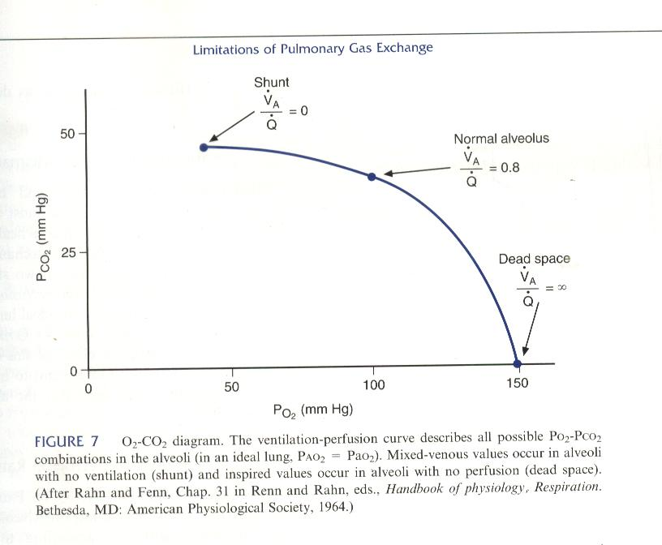
Pco₂ and Po₂ in an aveous

Slide 25
Local changes that occur in lung to minimize V/Q mismatch
In an underventilated area, resulting in hypoxia, hypercapnoea and increased H⁺;
there is vasoconstriction that shunts blood away from hypoxic area
In an underperfused area, resulting in low CO₂ levels;
bronchoconstriction shifts ventilation away from poorly perfused area

Slide 26
Respiratory Quotient
Internal respiration is the gas exchange between the systemic capillaries and the tissue cells
The ratio between the volume of oxygen consumed and the volume of carbon dioxide produced is called the respiratory quotient (RQ)
Normally, the tissues consume about 250 mL of oxygen each minute and produce about 200 mL of carbon dioxide
Calculation
RQ = CO₂ produced / O₂ consumed = 200 mL/min / 250 mL/min
= 200 / 250
= 0.8

Slide 27
Respiratory Exchange Ratio
External respiration is the gas exchange between the pulmonary capillaries and the alveoli
The gas exchange is between the body and the external environment
The quantity of oxygen and carbon dioxide exchanged during 1 minute is called the respiratory exchange ratio (RR/ RER)
Calculation is the same as for the RQ:
RQ = CO₂ produced / O₂ consumed = 200 mL/min / 250 mL/min
= 200 / 250
= 0.8
Under normal conditions, the RER equals the RQ.

Slide 28
Summary – In the lung
Blood flow and ventilation both increase from apex to base
BUT V_{A} >> Q is higher in the apex than the base
Therefore V_{A}/Q ratio decreases from apex to base
Ideally V_{A}/Q ratio = 1; Optimum V : Q matching
BUT For the whole lung at rest, V_{A}/Q ratio = 0.8
Due to ventilation perfusion mismatch in different parts of the lungs

Slide 29
Summary contd.
examples of ventilation-perfusion mismatch
↓ V_{A}/Q ratio
V_{A}/Q ratio=0
↑ V_{A}/Q ratio
V_{A}/Q ratio=α
“physiological shunt” – venous admixture, regional V_{A}/Q mismatch ; PaO₂ < P_{A}O₂
V_{A}/Q mismatch affects O₂ uptake more than CO₂ removal – next lecture

